Slide 1
Car Rental Application
The Car Rental Application is a user-friendly platform developed using PHP and hosted on the XAMPP server, aimed at facilitating the process of renting cars for users.

Slide 2
Introduction
The Car Rental Application is a user-friendly platform developed using PHP and hosted on the XAMPP server, aimed at facilitating the process of renting cars for users.
This application offers a comprehensive solution for both customers and administrators, allowing seamless interaction through a web-based interface accessible via a browser.

Slide 3
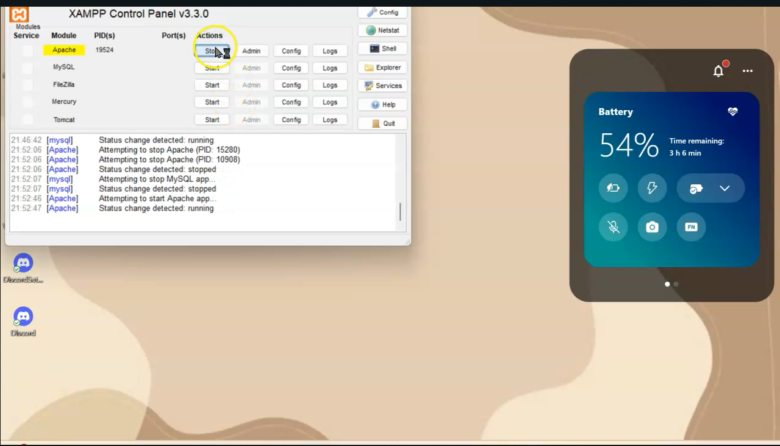
Xampp Server
Explanation of how XAMPP server is used to host the PHP backend:
Apache serves as the web server
MySQL manages the database
PHP handles server-side scripting

Slide 4
Database(php-admin)
Step-by-step guide to setting up the database in XAMPP:
Access phpMyAdmin via localhost
Create a new database for the car rental application
Import the provided SQL file to create tables and populate initial data
Using phpMyAdmin to create and manage the database:
Visual interface for database management tasks
SQL queries can also be executed directly

Slide 5
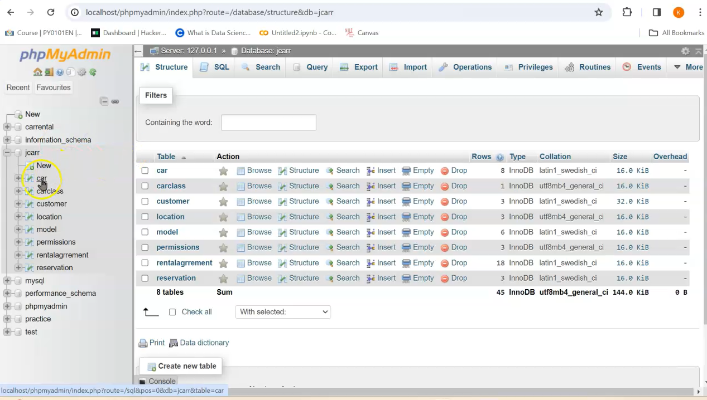
Database-setup(php-admin)

Slide 6
Admin Panel:
Separate interface for administrators.
Manage car inventory: add, edit, delete cars.
Manage customer data.
Approve bookings.
Generate reports.
Benefits:
Provides a user-friendly platform for car rental operations.
Streamlines the booking process for customers.
Offers comprehensive management tools for administrators.
Enhances efficiency and convenience for both users and administrators.

Slide 7
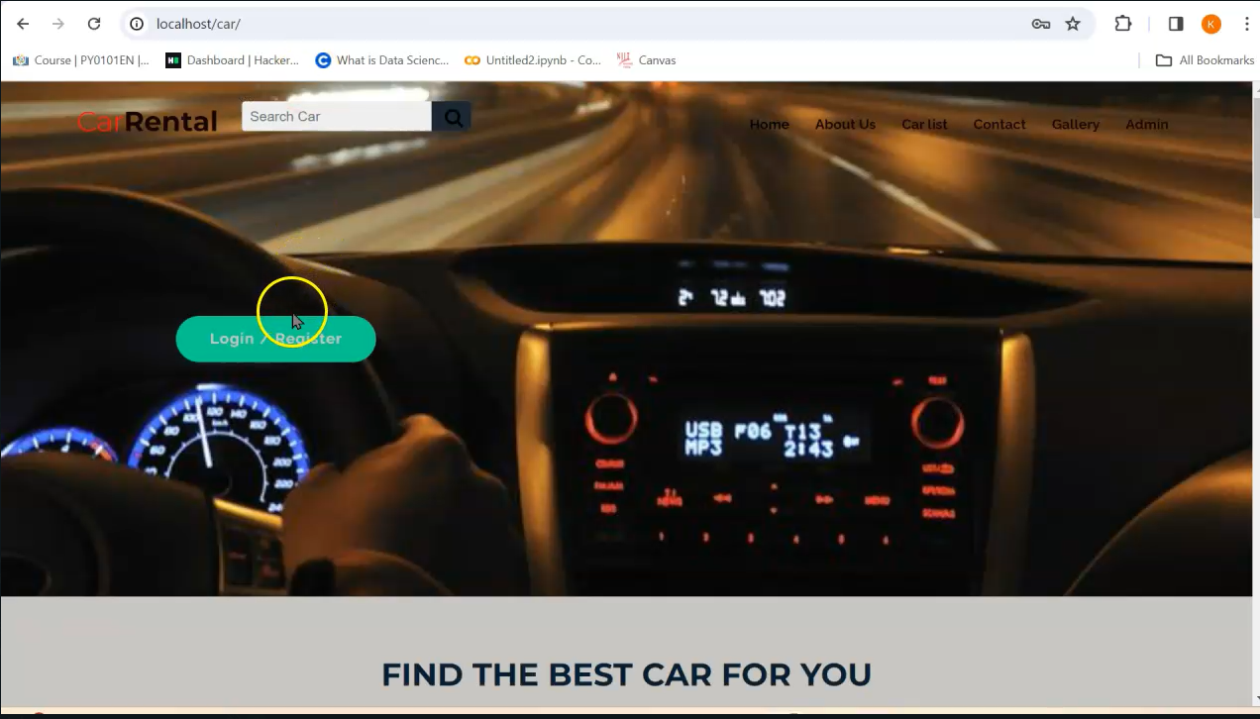
Slide 5: Interface Overview
Web-based interface accessible via a browser
Screenshots of the main pages: Home, Car Listings, Booking Form, etc.
Navigation and functionalities available to users:
Browse available cars, make bookings, view booking history, etc.

Slide 8
Booking Process
Explanation of the booking process for customers:
Browse available cars and select desired vehicle
Specify booking details: dates, pickup location, etc.
Confirm booking and receive confirmation email
Overview of the backend processes handled by PHP scripts:
Validating user inputs, updating database records, sending email notifications, etc.

Slide 9
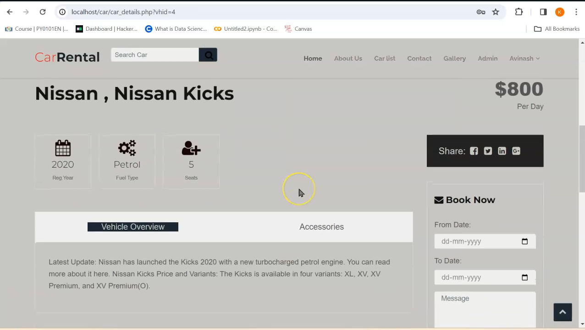
Booking Interface

Slide 10
Conclusion
The car rental application was developed using PHP, a server-side scripting language, and hosted on the XAMPP server, which provides an environment for PHP development.
The database setup involved creating tables for entities such as cars, customers, and bookings. This was managed using phpMyAdmin, a web-based interface for MySQL database management.
An overview of the user interface was provided, showcasing features such as browsing available cars, selecting vehicles, specifying booking details, and confirming bookings.
The admin panel offers functionalities for managing the car inventory, customer data, approving bookings, and generating reports, providing comprehensive control over the system.
The seamless integration of the PHP backend and XAMPP server ensures smooth and efficient handling of car rental operations, contributing to a seamless user experience.

